Slide 1
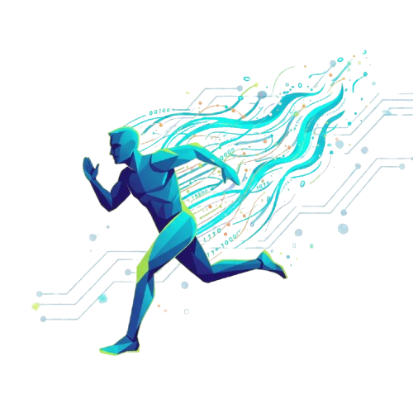


A MATLAB-Powered SMART FITNESS TRACKER
Team Name – AlgoRythms
Team Members - 1. Samiran Jana
2. Rajdeep Ray
3. Soumyadeep Datta
4. Susmit Thakur

Slide 2
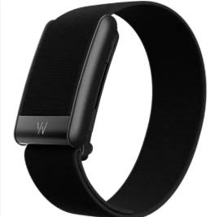
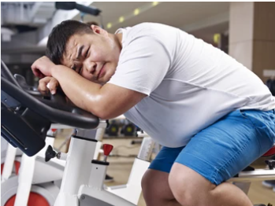
PROBLEM STATEMENT
CREATION OF OWN FITNESS TRACKER USING MATLAB
People today face sedentary lifestyles and rising health risks.
Existing fitness trackers are too costly or locked to premium ecosystems.
Many trackers give inaccurate results due to poor classification of activities.
Lack of affordable, data-driven alternatives accessible to everyone.

Slide 3
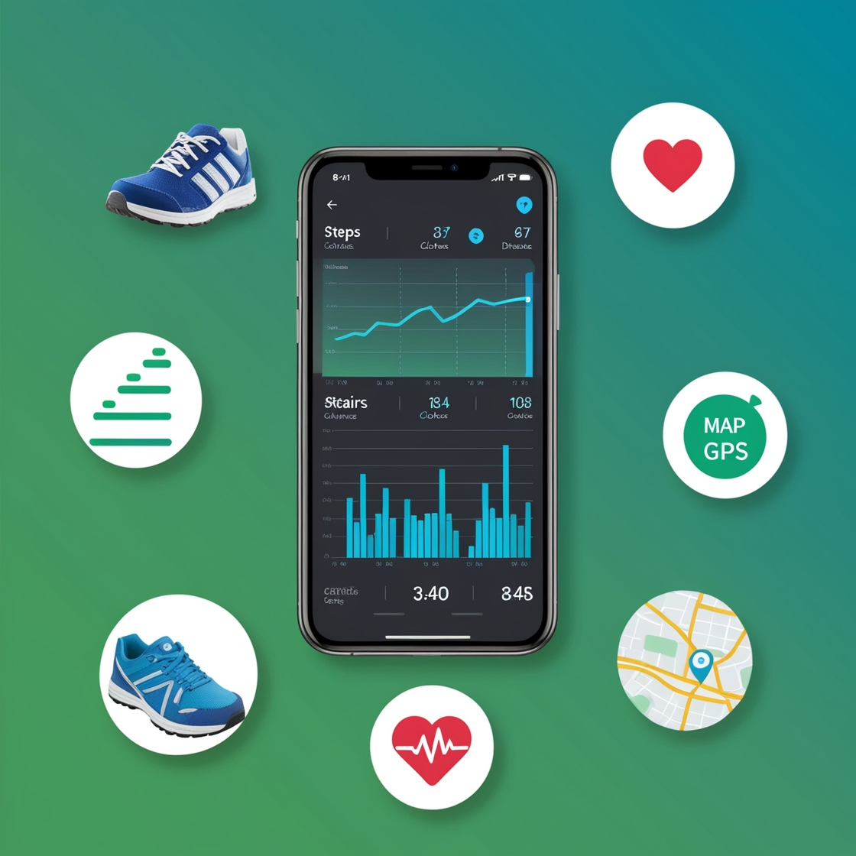
OUR SOLUTION TO IT
AI-powered activity detection – recognizes walking, running, stairs, sitting.
Accurate insights – steps, distance (Haversine), flights climbed, calories burnt.
Sensor-driven analysis – accelerometer, GPS & altitude combined.
Affordable & scalable – works on smartphones, no costly wearables needed.

Slide 4
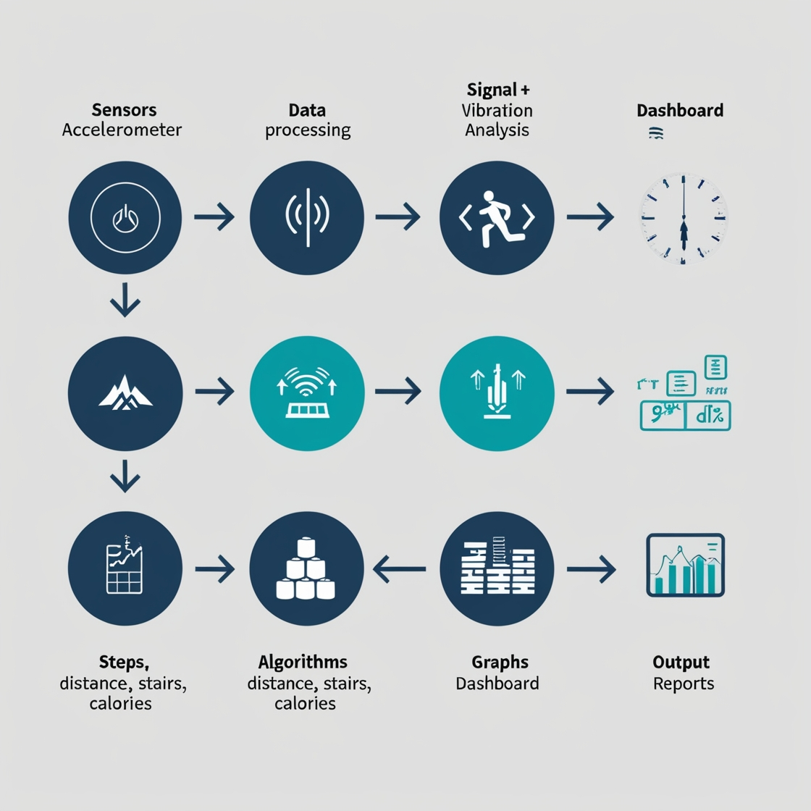
HOW OUR TRACKER WORKS
Data Capture – real-time input from phone sensors.
Processing – vibrations + orientation analyzed to detect motion.
Algorithms – peak & prominence for steps, Haversine for distance, altitude for stairs.
Output – health insights, visual reports, calorie tracking.

Slide 5
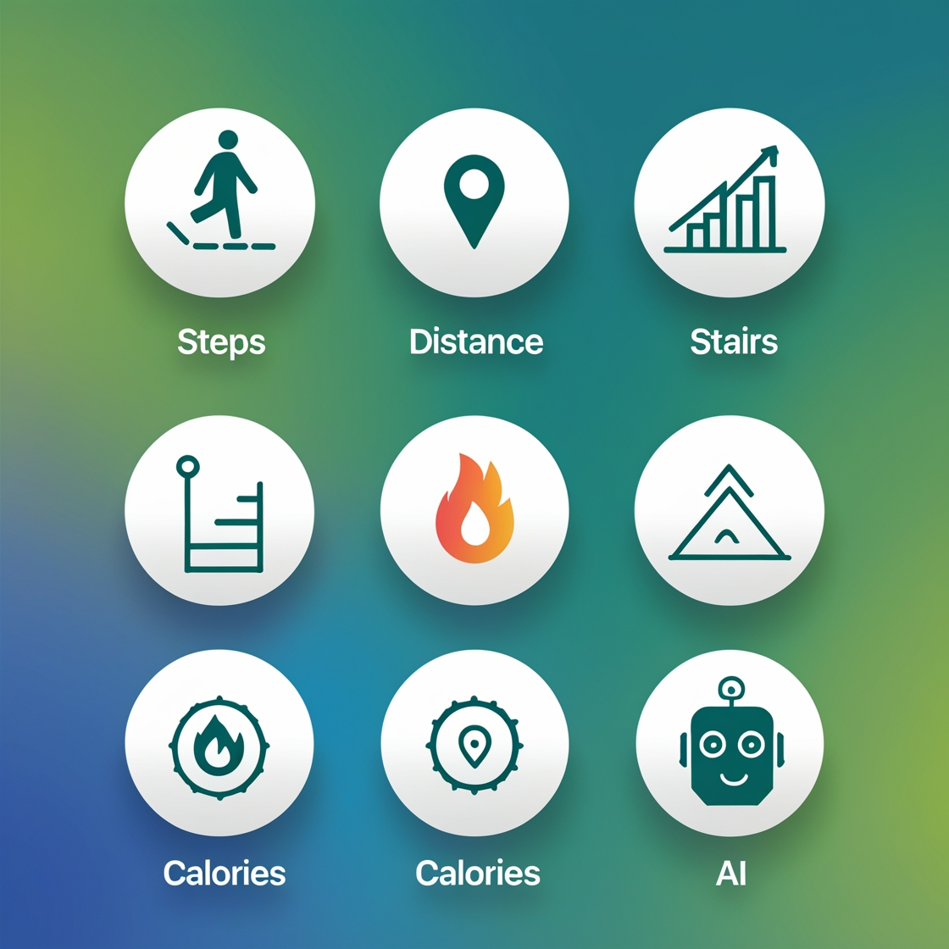
WHAT MAKES US UNIQUE !
Smart Step Counting – peak & prominence method for accurate results.
Calorie Estimation – MET-based, tailored by activity & body weight.
Precise Distance Tracking – Haversine formula for real-world accuracy.
Activity Fingerprinting – unique intensity + shakiness ID for classification.
Data Visualizations – heat maps, step graphs, and activity clusters.
Stair Climb Detection – altitude-based analysis, ignores small hills/noise.

Slide 6


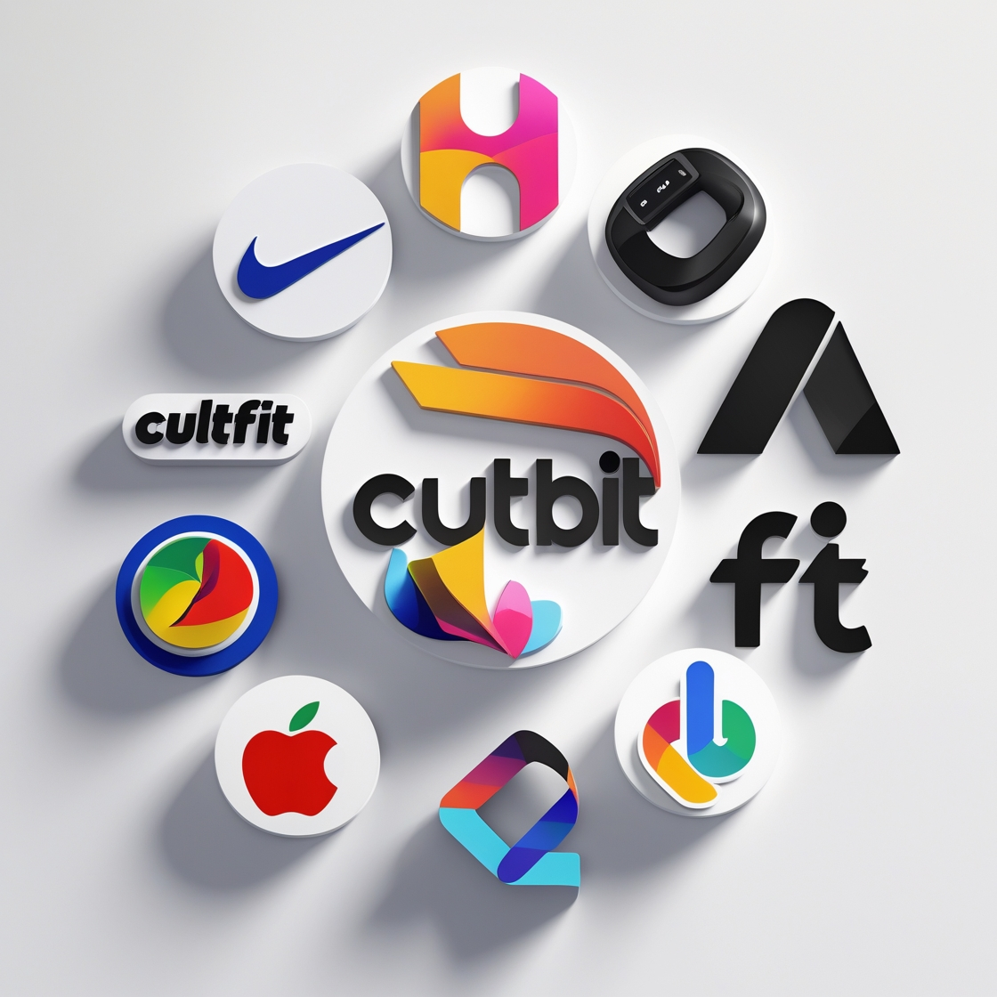
MARKET & BRANDS
🎯 Target Audience
Health-conscious students & professionals
Fitness enthusiasts & gym members
Elderly users seeking daily activity tracking
💰 Revenue Opportunities
Freemium app model (basic free, premium analytics)
B2B licensing for gyms, insurance, corporates
API integration for health/fitness platforms
🤝 Potential Partnerships
Fitness brands: Nike, Adidas, CultFit
Tech/Health apps: Fitbit, HealthifyMe, Apple Health, Google Fit

Slide 7

CONCLUSION
We built a smarter, affordable, and accurate fitness tracker.
Scalable for individuals, gyms, and global brands.
Our vision: democratize health tracking for everyone.
“Let’s make fitness accessible, accurate, and inspiring.”
--THANK YOU

